Slide 1
DETECTION OF FAKE NEWS
Abinaya. R
Vishnupriya. K
Sneha. D
Vanishree. P

Slide 2
OUTLINE
Abstract
What is fake news
Architecture of fake news
Works on architecture blocks
Advantages & Disadvantages
Steps for detecting fake news
Algorithm & Deployment
Conclusion
Reference
Future scope

Slide 3
ABSTRACT
With increasing popularity in the use of social media for news consumption, the substantial
widespread dissemination of fake news has the potential to adversely affect individuals as well as the
society as a whole. Even in the midst of the current covid-19 pandemic, false information shared on
websites such as WhatsApp, Twitter, and Facebook have the potential to cause panic and shock a
large number of people in various parts of the world.

Slide 4
WHAT IS THE FAKE NEWS ?
A type of yellow journalism, fake news encapsulates pieces of news that may be hoaxes and is generally spread through social media and other online media.
This is often done to further or impose certain ideas and is often achieved with political agendas. Such news items may contain false and/or exaggerated claims, and may end up being viralized by algorithms, and users may end up in a filter bubble.

Slide 5
DETECTING OF FAKE NEWS
To build a model to accurately classify a piece of news as REAL or FAKE.
This advanced python project of detecting fake news deals with fake and real news. Using sklearn, we build a TfidfVectorizer on our dataset. Then, we initialize a PassiveAggressive Classifier and fit the model. In the end, the accuracy score and the confusion matrix tell us how well our model fares.

Slide 6
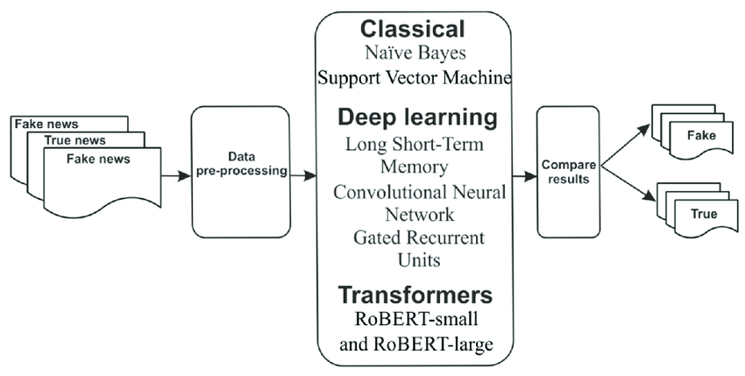
System Architecture

Slide 7
WORKS ON ARCHITECTURE BLOCKS
DATA PREPROCESSING :
In the preprocessing step, the data is cleaned such that the unwanted and unnecessary information
can be removed and only the relevant details will be kept. In this project we have used stemming and stopwords. There are different methods used in pre-processing.
Some of the methods are :
Stemming
Stopwords
Tokenization
DATASET :
The dataset we will use for this python project –we will call in news.csv .This dataset has a shape of 7796 *4.
The 1st column identifier the news the 2nd and 3rd are the tittle and text, and the fourth column has labels denoting whether the news is REAL or FAKE.

Slide 8
Data collection :
In the proposed system, the data is collected keeping in mind the current covid situation.
So we have collected the dataset which were publicly available on kaggle. We want through various
dataset and at last came up with dataset with maximum number of records.
Classical :
Naïve bayes algorithem
Deep learning :
Long sort term memory
Convolutional neural
Gated recurrent units
Transformers :
The transformers using ROBERT-SMALL and RODERT-LARGE
Result :
After the machine learing algorithm are done. The result will be predicted whether the news is REAL or
FAKE.

Slide 9
ADVANTAGES & DISADVANTAGES
ADVANTAGES
Advertisers take the advantages of fake news
Influencers also take benefits of fake news
Political warfare
Fun and Entertainment
DISADVANTAGES
Change in public opinion
Defamation is among the disadvantages of fake news
False perception
Fake news may lead to social unrest
Fake news cost lives

Slide 10
Steps for detecting fake news
Make necessary imports.
Read the data into a dataframe and get the shape of the data and the first five records.
Get the tables from dataframe.
Split the dataset into training and testing sets.
Initialize the TfidVectorizer.
Next we will initialize a passive aggressive classifier.
We got an accurancy of 92.82% with this model.

Slide 11
ALGORITHM & DEPLOYMENT
Make the necessary imports
import numpy as np
import pandas as pd
import itertools
from sklearn.model_selection
import train_test_split
from
sklearn.feature_extraction.text
import TfidVectorizer
from sklearn.linear_model import
PassiveAggressiveClassifier
from sklearn.metrics import
accurancy_score, confusion_matrix

Slide 12
2. Read the dataframe and get the shape of the data and first five records
#Read the data
df= pd.read_Csv
#get shape and head
df.shape
df.head()
3. Get the labels from the dataframe
#DataFlair – Get the labels
labels= df.label
labels.head()
4. Split the dataset into training and testing sets
#DataFlair – split the dataset
x_train, x_test, y_train, y_test= trainlabels, test_size =0 . 2, random_states

Slide 13
5. INITIALIZE A TfidfVectorizer
#DataFlair – Initialize a TfidfVectorizer
tfidf_vectorizer=TfidfVectorizer( stop_words=‘english’, max_df=0.7)
tfidf_train=tfidf_vectorizer. fit_transform (x_train)
tfidf_test=tfidf_vectorizer. transform(x_test)
6. We will Initialize PassiveAggressiveClassifier
Pac=PassiveAggresiveClassifier(main)
Pac. Fit ( tfidf_train, y_train)
y_pred= pac.predict (tfidf_test)
Score=accurancy_score( y_test , y_prdict )
Print ( f’Accurancy : {round (score*10) } )
7. We got an accurancy of 92.82% with this model
Confusion_matrix(y_test,y_pred ,
Labels=[ ‘FAKE’,’REAL’ ] )

Slide 14
CONCLUSION
We learned to detect fake news with python. we took a political dataset implemented a TfidfVectorizer, initialized a PassiveAggressiveClassifier, and fit our model. We ended up obtaining an accurancy of 92.82% in magnitude. Through utilization of different kind of learning algorithms this paper is aimed to exploit difference aspects of dataset which not deeply considered in literature and to find a good way of detection of the fake and automated accounts. As a future better detection of fake accounts and the can be applied to various social online platforms such as Instagram, LinkedIn and twitter to the fake accounts.

Slide 15
REFERENCE
December 17,2016. “what is fake news? How to spoil it and what you can do stop it”. The Guardian.Retrived January 15,2017.
“ The real story of ‘fake news’. The term seems to have emerged around the end of the 19th century”. Merriam- website. Retrived October 13,2017.
Soll,Jacob (December 18,2016).” The long and brutal history of fake news”. Politico Magazine. Retrived March 25,2019.
Himma – kadakas,marju( July 2017 ).” Alternative facts and fake news entering journalistic content production cycle”. Cosmopolition civil societies.
Tuefekci, Zeynep (January 16, 2018).” it’s the democracy poisoning golden age of free speech”. Wired.

Slide 16
FUTURE SCOPE
We are interested in IT field jobs.
PROGRAMMER
JAVA or SQL DEVELOPER
WEBSITE CREATOR

Slide 17
“ THANK YOU “

